Slide 1
Judicial System of Bangladesh
Md Anwarul Islam Sikder ndc
Former Secretary

Slide 2
Session Plan
Sl | Items | Minute
1 | Courts in Bangladesh | 05
2 | The Supreme Court of Bangladesh | 10
3 | Civil & Criminal Courts | 20
4 | Court of Session & Court of Magistrates | 15
5 | Courts/Tribunals of special jurisdiction | 10
6 | Good to know: Some issues | 20
7 | Q & A | 10
 | Total | 90

Slide 3
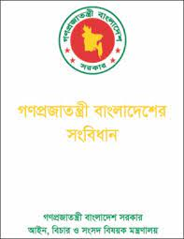
Bangladesh Constitution
Constitution: The basic source of law
Part VI:
Article 94-113: The Supreme Court
Articles 114-116A: Subordinate Court
Article 117: The Administrative Tribunal

Slide 4
Courts in Bangladesh
Can be discussed under 3 main heads:
The Supreme Court of Bangladesh
Courts of Sessions and District Judges Courts (Subordinate Courts)
Tribunals and Special Courts (Constitutes under Special Laws)

Slide 5
Courts in Bangladesh
The Supreme Court of Bangladesh
Appellate Division &
High Court Division
Subordinate Courts
Court of District Judge
Court of Additional District Judge
Court of Joint District Judge
Court of Senior Assistant Judge
Court of Assistant Judge
Court of Session Judge
Court of Additional Session Judge
Court of Joint District Judge

Slide 6
Courts in Bangladesh
Court of Chief Metropolitan Magistrate
Court of Addl. Chief Metropolitan Magistrate
Courts of Other Metropolitan Magistrate
Court of Chief Judicial Magistrate
Court of Addl. Chief Judicial Magistrate )
Court of Judicial Magistrate
Courts of the First Class, Second Class & Third Class Magistrate

Slide 7
HL-Courts in Bangladesh.mp4

Slide 8
A.The Supreme Court
Article 94(1): Supreme Court of Bangladesh comprising two divisions –
the AD and the HCD.
The Supreme Court shall consists of the Chief Justice of Bangladesh and such number of other Judges as the President may deem to necessary to appoint to each division. Article 94(2)

Slide 9
The Appellate Division: Jurisdiction
The AD has jurisdiction to “hear and determine appeals” against “judgments” decrees, orders or sentences’ passed by the HCD (Article 103(1)).
It has also an advisory jurisdiction.

Slide 10
The HCD: Jurisdictions
The HCD has “special and statutory original, revisional, admiralty, appellate and other jurisdictions (Article 101).
Under special original jurisdiction, it is authorized to enforce fundamental rights of the citizens and to issue certain orders and directions in the nature of writs of prohibition, mandamus, certiorari, habeas corpus and quo-warranto (Article 102).

Slide 11
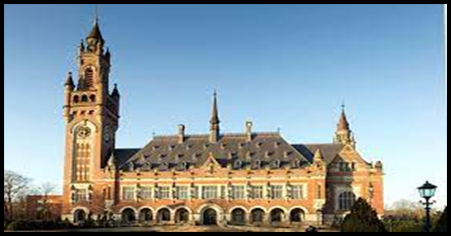
Jurisdiction of the AD
No original jurisdiction.
The sources are:
A.The Constitution; and
B. Ordinary law.
A. The Constitution:
a. Appellate jurisdiction;
b. Jurisdiction as to issue and execution of process;
c. Jurisdiction as to review; and
d. Advisory jurisdiction.

Slide 12
a. Appellate jurisdiction
The appellate jurisdiction applies only against the judgment, decree, order or sentence of the HCD
Two magnitudes:
1. appeal lies as of right; in following three cases:
Where HCD certifies that the cases involves a substantial questions of law as to interpretation of constitution;

Slide 13
a. Appellate jurisdiction
Where the HCD sentences a person to death or imprisonment for life; and
Where HCD punishes a person for its contempt.
2. Appeal can be made if the AD grants leave to appeal.

Slide 14
Jurisdiction of HCD
Supervisory power over subordinate court/ tribunal :
Want or excess of jurisdiction;
Failure to exercise jurisdiction;
Violation of procedure or disregard of principles of natural justice; and
Findings based or no materials, or order resulting in manifest injustice.

Slide 15
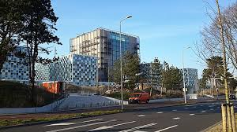
B. Subordinate/Lower Courts
Two broad categories namely:
Civil and Criminal Courts.
Separated in 1st Nov 2007
However, Mobile Court Act 2009 has given some judicial powers to the Executive Magistrates.

Slide 16
Civil court
Created under the Civil Courts Act of 1887.
Five tiers of civil courts in a district:
Court of District Judge.
Court of Additional District Judge.
Court of Joint District Judge.
Court of Senior Assistant Judge.
Court of Assistant Judge.
The first two are generally courts of appeal in civil matters,

Slide 17
Civil court
1. Court of the District Judge.
Mainly an appellate court, limited original jurisdiction.
District Judge hears and determines appeals against Joint District Judges’ judgments, decree or orders
The District Judge’s pecuniary jurisdiction is unlimited and he has power to delegate his function or transfer appeal to the Additional District Judge or any other civil court

Slide 18
Civil court
2. Court of Additional District Judge.
Similar to the District Judges’ except that they cannot receive appeals from any inferior courts
3. Court of Joint District Judge.
The Court of Joint District Judge exercises both original and appellate jurisdiction. All cases, which exceed the pecuniary jurisdiction of Senior Assistant Judge, are filed in the Court of the Joint District Judge. The jurisdiction of the Court of Joint District Judge extends to all original suits without any pecuniary limit.

Slide 19
Civil court
4. Court of Senior Assistant Judge.
The Court of Senior Assistant Judge has original jurisdiction and appeal from this court lies to the Court of the District Judge. Moreover, the Court of Senior Assistant Judge acts as the Family Court and also acts as the Election Tribunal
5. Court of Assistant Judge
All civil suits are filed in the Court of Assistant Judge

Slide 20
Criminal Courts
The Code of Criminal Procedure 1898.
Two classes of Criminal Courts
a. Courts of Sessions
b. Courts of Magistrates
The subordinate criminal courts
Courts of Session Judge.
Court of Additional Session Judge.
Court of Joint Session Judge.
Court of Chief Metropolitan Magistrates (CMM).
Court of Additional CMM.
Court of Magistrates of the First Class.
Court of Magistrates of the Second Class.
Court of Magistrate of the Third Class.

Slide 21
A. Courts of Session
Three tiers of judges, namely,
Sessions Judge,
Additional Sessions Judge and
Joint Sessions Judge.
Sessions Judge and Additional Sessions Judge hold same powers, while Joint Sessions Judge enjoy lesser powers. A Sessions Judge and an Additional Sessions Judge may impose any penalty including the death penalty prescribed by law

Slide 22
Courts of Session
The Court of Session for a metropolitan area is known as the Metropolitan Court of Session.
All Joint Session Judge shall be subordinate to the Sessions Judge in whose Court they exercise jurisdiction and all Judicial Magistrates including to the Chief Judicial Magistrates shall be subordinate to the Metropolitan Session Judge

Slide 23
B. Court of Magistrates
Section 6(2) of CrPC: 2 types of magistrate court:
Judicial and Executive Magistrates
Four types of Magistrates:
CMM in metropolitan areas and Chief Judicial Magistrate in other areas,
Magistrates of the first class,
Magistrates of the second class and
Magistrates of the third class.

Slide 24
Executive Magistrate
Section 10 of CrPc 1898
In every district and in every metropolitan area:
The District Magistrate
Additional District Magistrate, with all or any of the powers of a DM.
All Assistant Commissioners, ADCs or UNOs in any district or Upazila shall be Executive Magistrate.

Slide 25
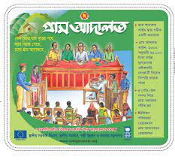
Village Court
Composition:
Chairman and 4 members, consisting two members from both sides.
From each side one member be member of Union Parishad and one member be a woman.
Power of VC: up to BDT 75,000
Revisional Court: Assistant Judge
Appelate Court:
Schedule 1: Magistrate 1st Class, Sch. 2: Asst Judge

Slide 26
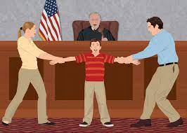
Courts &Tribunals of special jurisdiction
Both civil and criminal, established by law and constitutional provisions
In civil area
Labour Courts
Family Courts,
Money Loan Courts,
Bankruptcy Courts,
Income Tax Tribunals,
Administrative Tribunals,
Election Tribunals, etc.

Slide 27
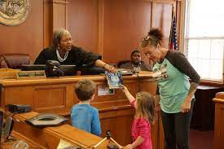
Courts &Tribunals of special jurisdiction
In criminal area
Special Tribunals,
Public Safety Tribunals,
Tribunals Against Repression of Women & Children, .
Village Courts.
Artho Reen Adalat etc
All Session Judges, Addl Session Judges or Asst Session Judges act as judges of Special Tribunals

Slide 28
Courts &Tribunals of special jurisdiction
Court of Special Judge.
The Special Judges may be appointed from among Sessions Judges, Metropolitan Magistrates or Magistrates of the first class.

Slide 29
Administrative/Admn. Appellate Tribunal.
Administrative Appellate Tribunals:
one chairman and two other members.
The Chairman: is, or has been, or is qualified to be a Judge of the Supreme Court, Two members: is or has been an officer not below the rank of joint Secretary and the other: is or has been a District Judge.
Labour Courts
The chairman is appointed from amongst the district judges or additional district judges and one of the members is appointed in consultation with the employers and the other in consultation with the workmen.

Slide 30
Court of Settlement
Chairman : persons who are or have been or are qualified to be a judge or additional judge of the Supreme Court.
One are or have been judicial officers not below the rank of additional district judge and the other are or have been officers not below the rank of a deputy secretary.

Slide 31
Arbitration and Arbitration Appellate Tribunal
Any person aggrieved by an order of assessment of compensation of requisition or acquire any land or building may file an application to the Arbitrator appointed by the government from amongst persons holding post not below the rank of the joint district judge.
An appeal lies to the Arbitration Appellate Tribunal constituted with a member appointed from amongst persons who are or have been district judges against the award of the Arbitrator.

Slide 32
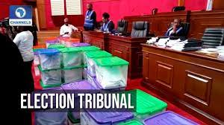
Other courts
Election Tribunals
Vested Roperty Return Tribunal and Appellate Tribunal
Land Survey Tribunal and Appellate Tribunal

Slide 33
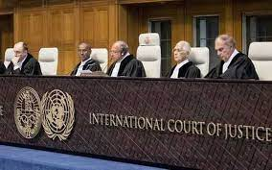
Good to know
Criminal & Civil law
The CrPc 1898 (565)
The CPC 1908 (511)
The Penal Code 1860
The Evidence Act 1872
The PRB 1943 (1290)
CrPC Section 54
Section 107
Section 144
Section 161
Section 164

Slide 34
Good to know
Affidavit
Bail
Bail Bond
PRB 15
Burden of proof
Estoppel
Warrant and Summoned

Slide 35
Good to know
Personal experience
Indemnity to Judges
Mens Rea
Preference to acquittal
Prima facie

Slide 36
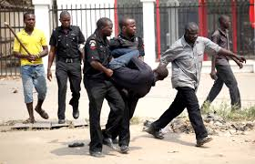
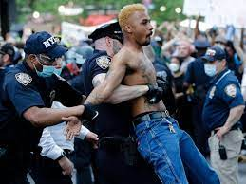
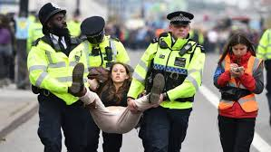
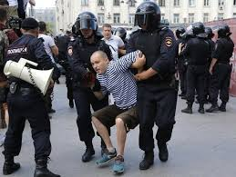
Let’s Identify
1
2
3
4
5
6

